Slide 1
NEWS-PPRO
NEWS-PPRO: News Extraction With Sentiment Analysis for Price Prediction and Real-time Outlook
Changing trading one stock at a time
By: Punit

Slide 2

1
Background
2
Trader’s Dilemma
Contents
3
The Solution
4
Source
5
Demo

Slide 3
6
Benefits
Contents
7
Future Additions
8
Disclaimer

Slide 4
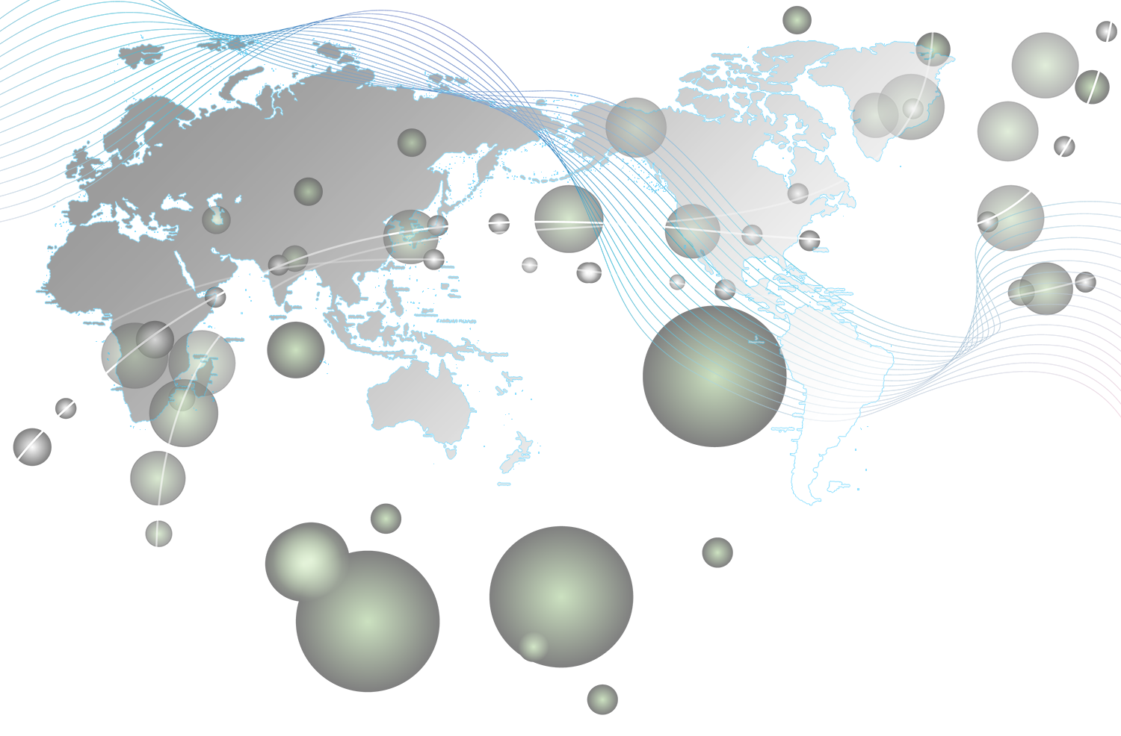

Alaska
Blueland
Our Stock Market Of Choice
Brazil
Might be Africa

Slide 5

Background
Historical Origin: Established in the late 19th century, the Indian stock market is one of Asia's oldest.
Dual Structure: Comprising the Bombay Stock Exchange (BSE) and National Stock Exchange (NSE), it operates with a dual exchange structure.
Regulatory Oversight: The Securities and Exchange Board of India (SEBI) regulates and oversees the market.
Segments: It includes equity, derivatives, commodities, and currency markets, catering to a diverse range of investors.
Global Integration: Increasingly integrated with global markets, attracting foreign investments and collaborations
Dematerialisation, Market Participants, Performance & Technology, Economic Significance
01

Slide 6
02
Trader’s Dilemma

Slide 7

Challenges: Traders face information overload, market volatility, risk assessment and regulatory compliance hurdles.
Timeliness: Real-time access to news is critical for making informed decisions.
Impact: Timely information empowers traders to make informed decisions, mitigate risks, identify profit opportunities, and maintain a competitive edge.

Slide 8

The Solution
Introducing Our Excel App: We offer a user-friendly Excel app tailored for stock monitoring and sentiment analysis
Key Features: Real-time stock tracking, integrated news feeds, sentiment analysis, risk assessment, and data visualization.
Benefits: Timely insights, informed decisions, risk mitigation, profit opportunities, and a competitive advantage for traders.
03

Slide 9

Source
Market Volatility: Opportunities in market fluctuations.
Diverse News: Various sectors, diverse news.
Global Impact: International events matter.
Speedy Response: Algorithms react faster.
Data-Rich: Abundant data for accuracy.
SEBI Oversight: Regulatory trust.
Profit Potential: Competitive edge.
Risk Control: Swift response to risks.
Always On: 24/7 news monitoring.
04

Slide 10


Zooming In
Money control - Comprehensive coverage, Real-time updates, News Coverage, Historical Data, Market Tools, User-Friendly Interface, Mobile Accessibility, Research Reports. educational Resources, Community and forums, API Access

Slide 11

We can only predict the future state of the stock based off the past highs and lows.

Slide 12
02
NEWS-PPRO

Slide 13
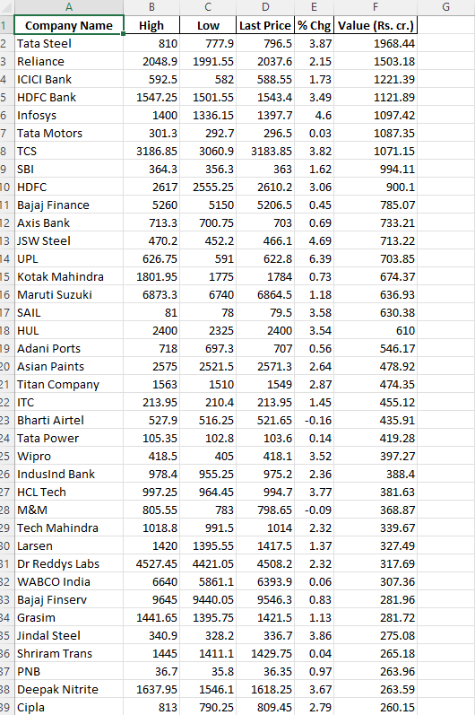
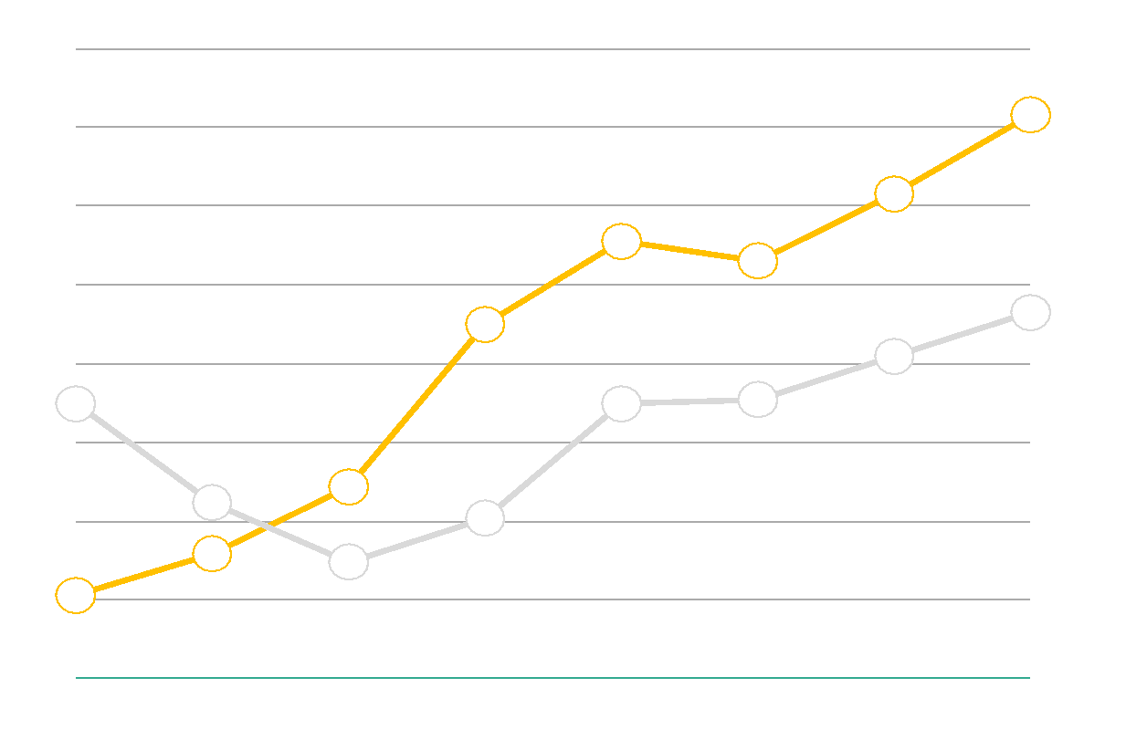
Basic Insights
display data
Basic model just display data using web scraping from MoneyControl
https://www.moneycontrol.com/stocks/marketstats/nsemact1/index.php

Slide 14


NEWS-PPRO
News Analysis
For people who are not in line with daily news and cannot understand if the news is good or bad about something

Slide 15
NEWS-PPRO
RSS
News Sources
Stock Prices
Sentiment
Market Analysis
Display

Slide 16
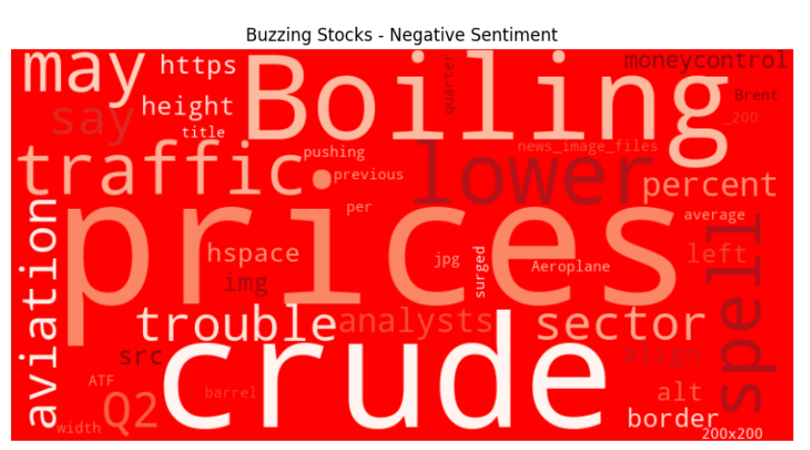
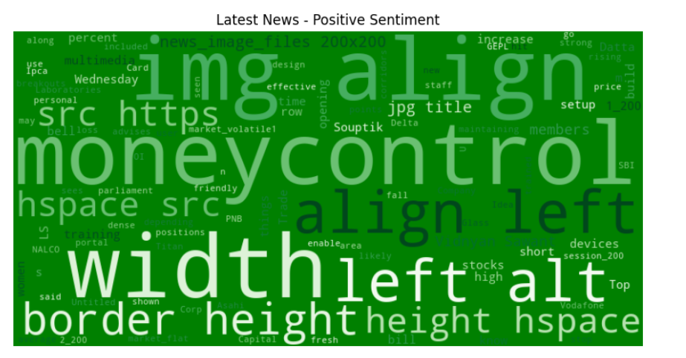
NEWS-PPRO
Examples of displays
Corpus Training
The corpus for sentiment analysis has not been trained very well need more time and training to improve

Slide 17

NEWS-PPRO
Portfolio news analysis
In this we provide service where the user can provide the stock in the portfolio and then we run advance sentiment analysis by giving weight to its own stock previous news and how much it affect the stock price to give more accurate idea for the user to take actions

Slide 18
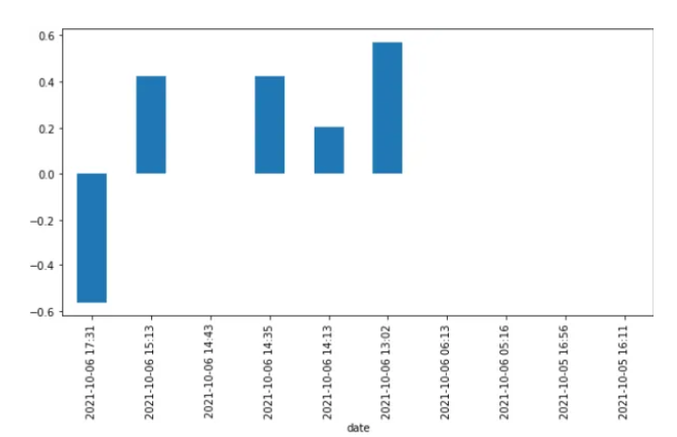
NEWS-PPRO
We take previous news data and train our sentimental model and check if we get similar result and we also collect its stock data of the day of the news.

Slide 19
03
Live Demonstration

Slide 20
04
Benefits

Slide 21
Let their powers combine
News Sources for Sentiment Analysis
Stock Price Data Machine Learning
Our Website is easy to use
Educate general public about stock

Slide 22
08
Future Additions

Slide 23
Future Additions
Better servers
Feedback updates
Community Add-ons
Add more equipments to increase computational power and better storage
Constant updates based off community/company feedback
Online forum to upload custom community-made add-ons to the product

Slide 24
THANKS

Slide 25

Disclaimer: Important Information Before Using Our Website
Thank you for visiting our website for stock price predictions based on news. Before you continue to use our services, we want to ensure that you fully understand the nature of our platform and the associated risks. Please carefully read and consider the following disclaimer:
Information Accuracy: Our website utilizes advanced algorithms to analyze news data and predict potential stock price movements. However, these predictions are not infallible and are based on historical data and trends. Always remember that the stock market is inherently volatile and subject to sudden changes. Our predictions should not be considered as financial advice or absolute guarantees.
No Financial Advice: We are not financial advisors, and the information provided by our website should not be interpreted as personalized financial advice. You should consult with a qualified financial professional before making any investment decisions.
Risk of Loss: All investments in the stock market involve a degree of risk. You may lose some or all of your invested capital. Our website does not assume responsibility for any losses incurred as a result of using our service.
News Sources: Our website relies on publicly available news sources for data analysis. The accuracy and timeliness of this news data are beyond our control. We cannot guarantee the completeness or accuracy of the information used in our predictions.
Market Volatility: Stock prices can be influenced by a wide range of factors, including global events, economic conditions, and investor sentiment. These factors can change rapidly, making it difficult to predict stock price movements with certainty.
Legal Considerations: It's important to comply with all relevant laws and regulations when making investment decisions. Always adhere to the legal and regulatory requirements in your jurisdiction.
User Responsibility: By using our website, you acknowledge that you are solely responsible for your investment decisions and any consequences that may result from them. You should perform your own research and exercise caution when making investment choices.
No Guarantees: Our website does not provide any guarantees or warranties regarding the accuracy or reliability of its predictions. Stock markets are influenced by a multitude of factors, and our website cannot account for all variables.
User Agreement: Your use of our website is subject to our terms of service, which outline the terms and conditions governing your access and usage. Please read our terms of service carefully before using the website.
Feedback and Improvements: We welcome user feedback and continuously strive to improve our website's performance and accuracy. If you encounter any issues or have suggestions for improvement, please contact our support team.
By using our website, you acknowledge that you have read and understood this disclaimer and agree to abide by its terms. Remember that all investments carry inherent risks, and past performance is not indicative of future results. Use our website as a tool for information and analysis, but always exercise due diligence and seek professional advice when making investment decisions.

